Slide 1





Monthly Report
1st august-31st august

Slide 2
Social Media Pages Posts Metrics (All Brands)

Slide 3
SRC SOCIAL MEDIA INSIGHTS

Slide 4
SRC SOCIAL MEDIA INSIGHTS (Continued)

Slide 5
SRC LEATHER DIVISION SOCIAL MEDIA INSIGHTS

Slide 6
SAAF N SAFE SOCIAL MEDIA INSIGHTS

Slide 7
SIDEX SOCIAL MEDIA INSIGHTS

Slide 8
FIXO SOCIAL MEDIA INSIGHTS

Slide 9
TAZA SOCIAL MEDIA INSIGHTS

Slide 10
SRC POST CAMPAIGNS

Slide 11



Posts were designed to promote the importance of sustainable system at SRC.

Slide 12



Posts were designed to promote the leather chemicals process, trendy events and Special Day.

Slide 13
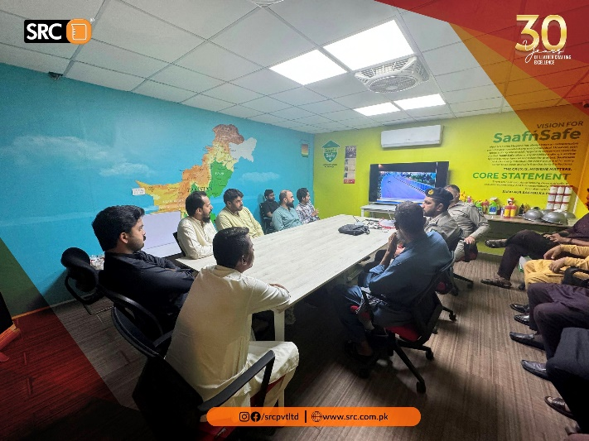
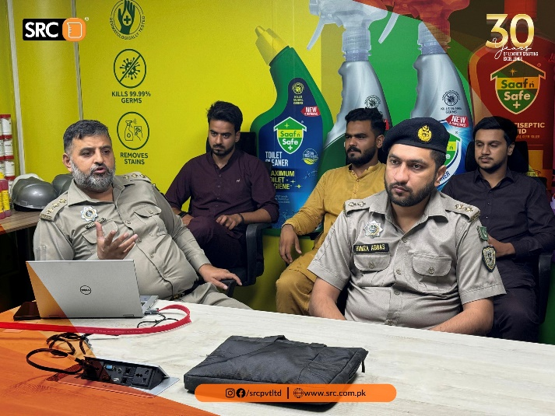
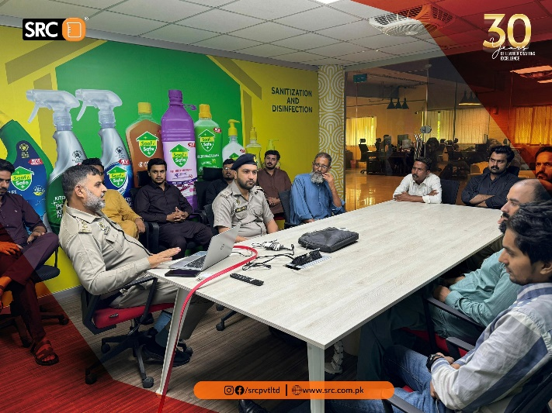
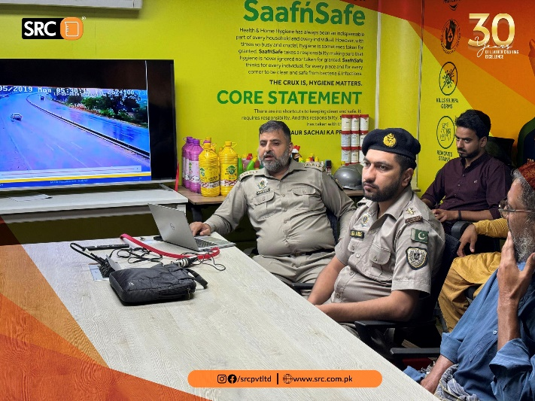
Posts were designed to cover the motorway traffic police session.

Slide 14
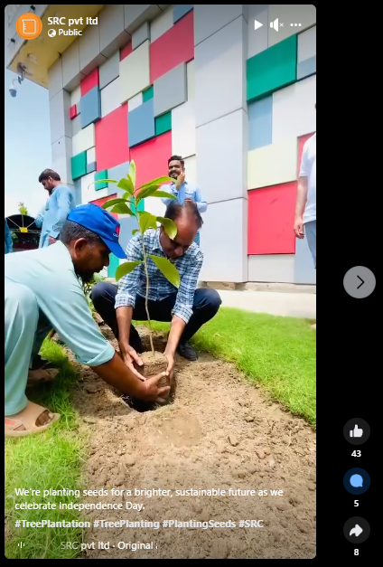
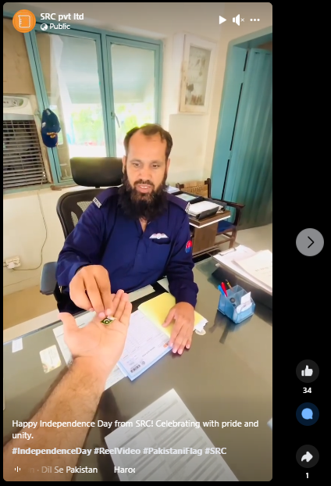
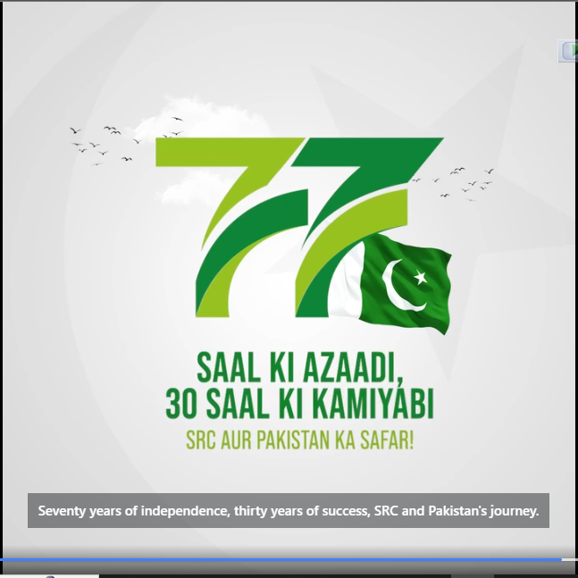
Posts were designed to celebrate independence day with full esteem and collaboration with employees.

Slide 15

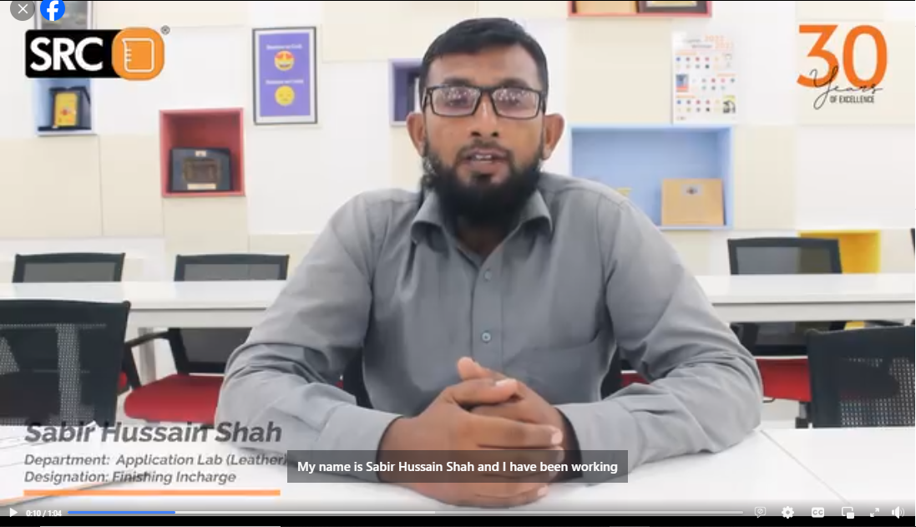
Posts were designed to remember the skills and abilities employees are providing at SRC Pvt Ltd.

Slide 16
SRC LEATHER DIVISION POST CAMPAIGNS

Slide 17

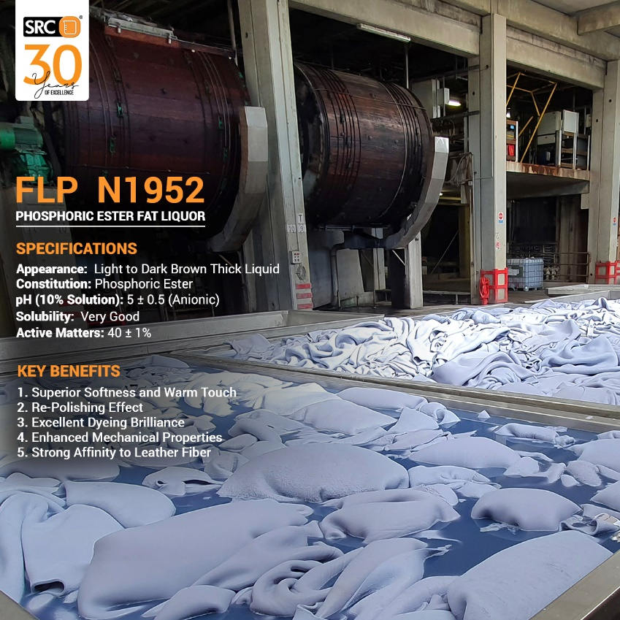
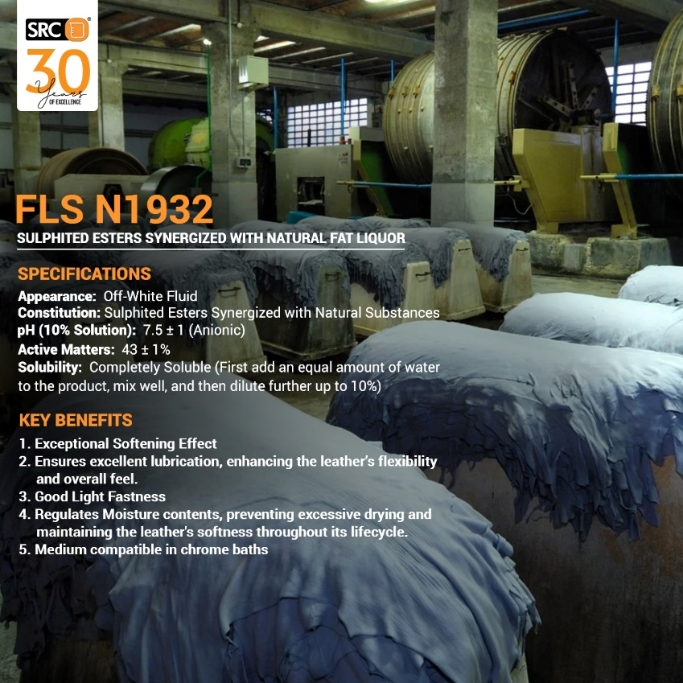
Posts were designed to showcase the Fat Liquor Leather chemical products of SRC.

Slide 18
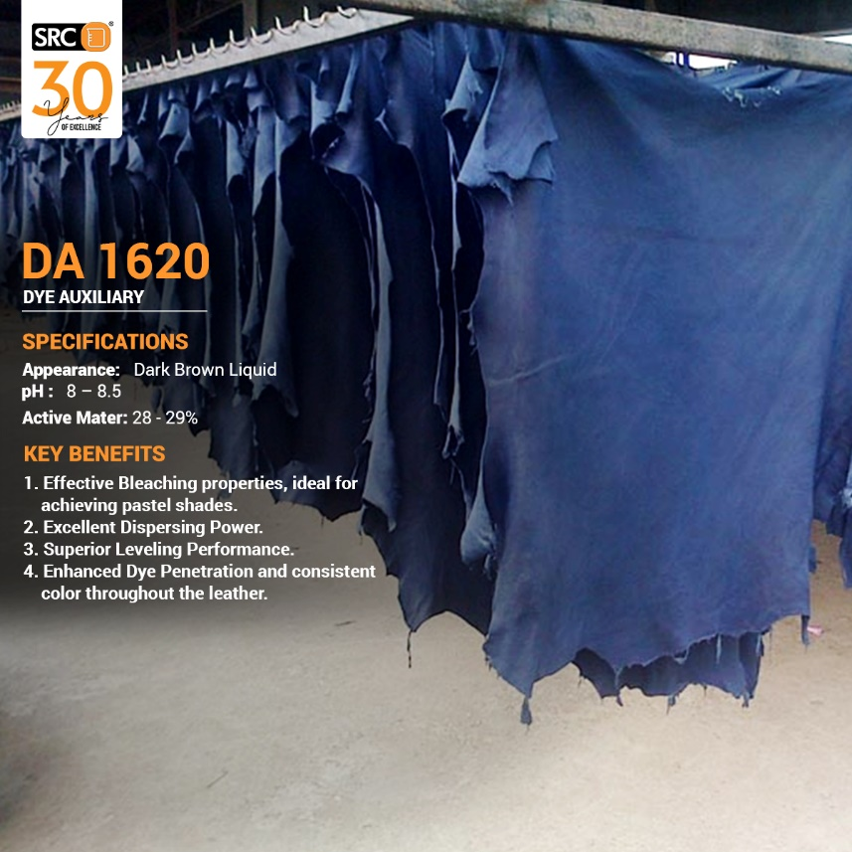
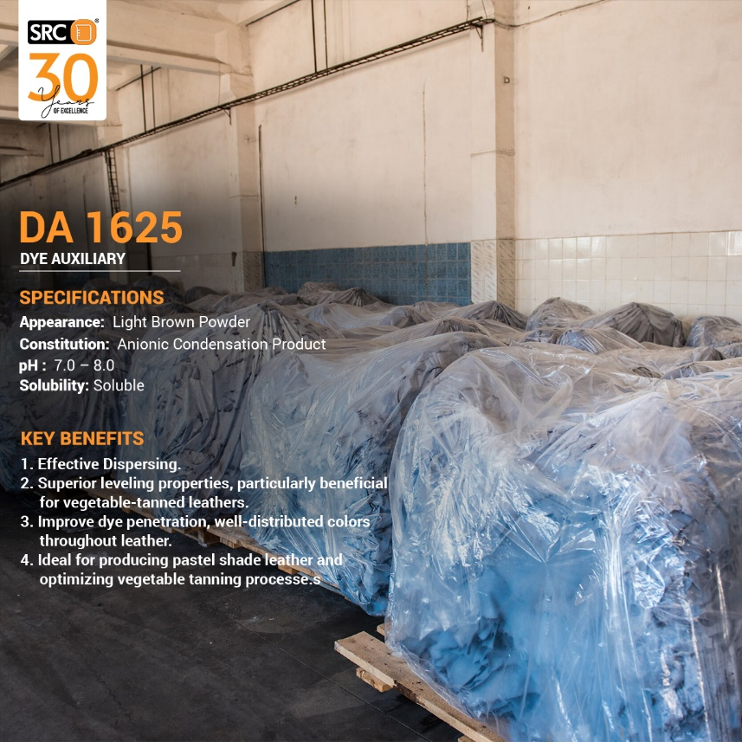
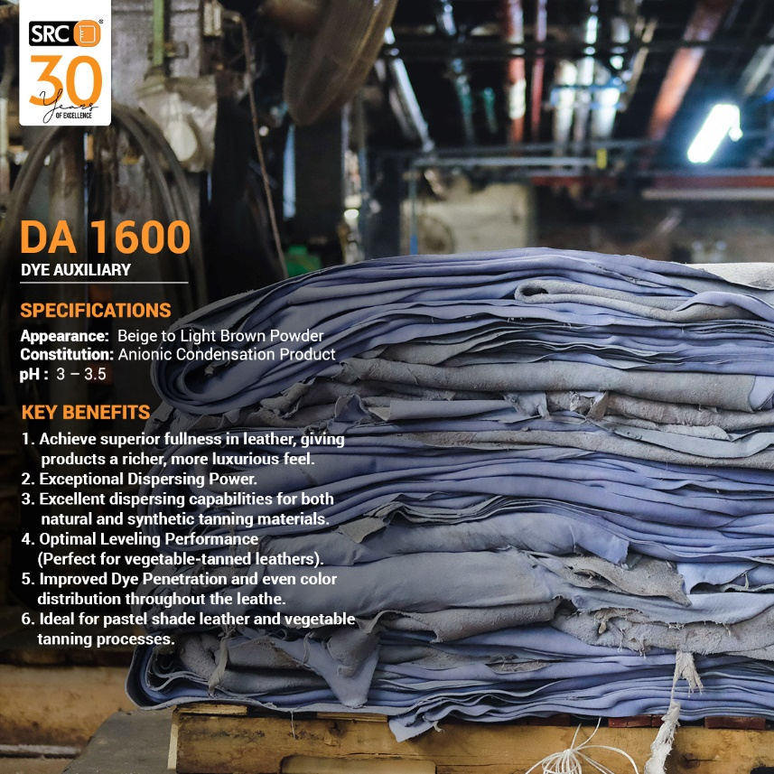
Posts were designed to promote Dye Auxiliaries of SRC.

Slide 19
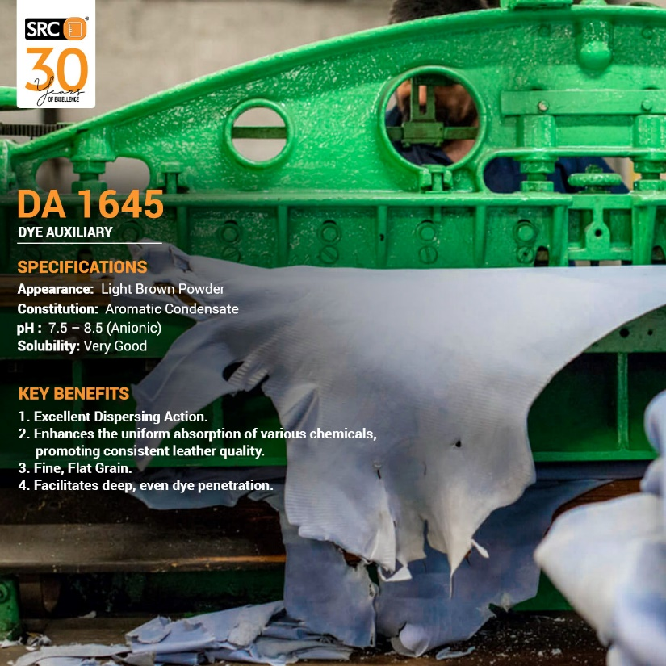
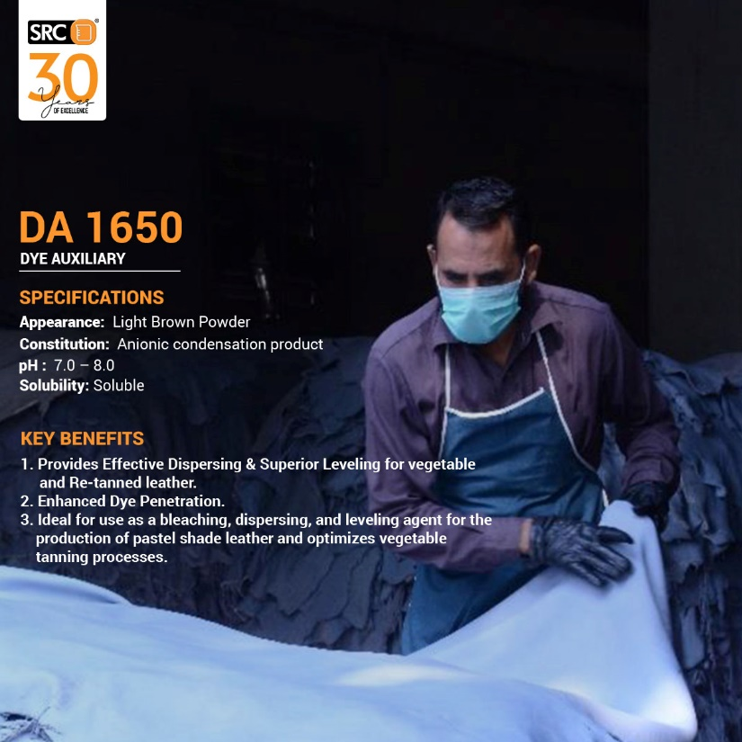
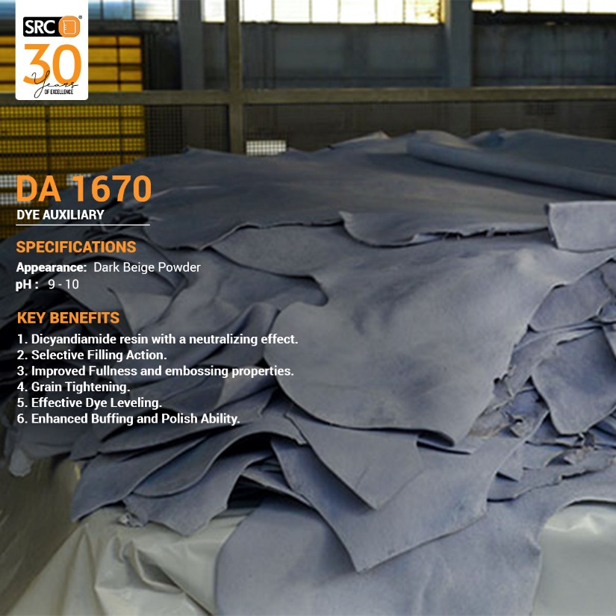
Posts were designed to promote Dye Auxiliaries of SRC.

Slide 20
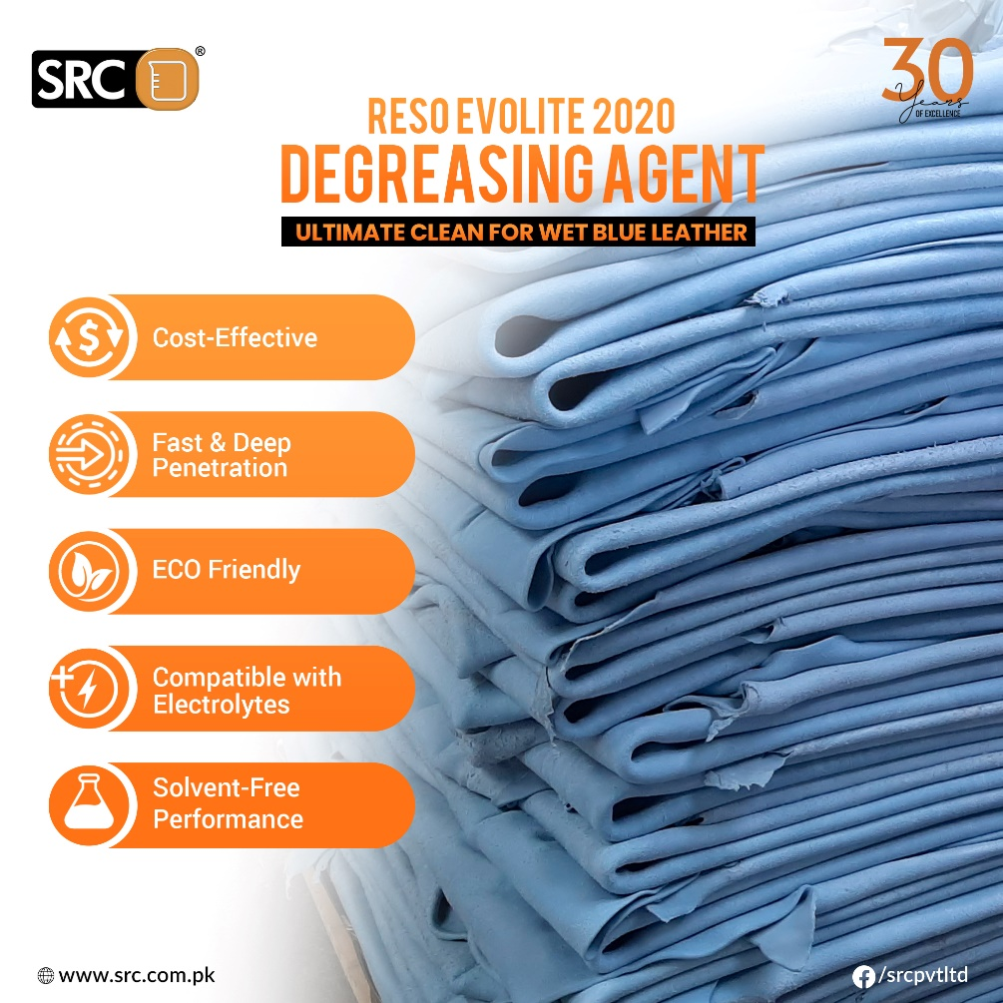

Posts were designed to promote Reso Evolite 2020 Key Features and commemorate a Special Day.

Slide 21
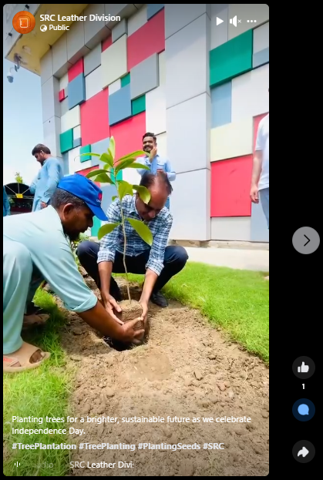
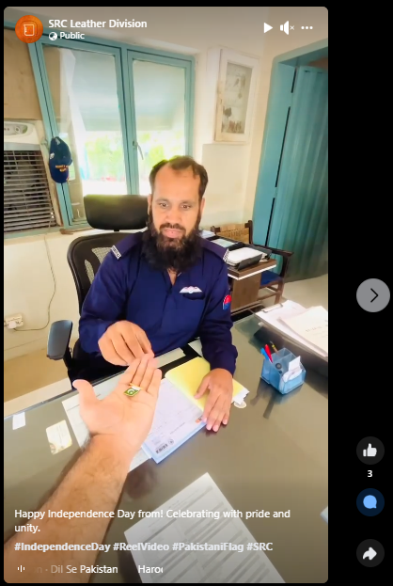

Posts were designed to celebrate Independence Day with full esteem and collaborations with employees.

Slide 22
SAAFNSAFE POST CAMPAIGNS

Slide 23



Posts were designed to celebrate Independence Day with SaafnSafe's Azadi Discounts on all products!

Slide 24


Posts were designed to recall the trendy events and the Special Days.

Slide 25



Posts were designed to promote the Lavendar and Fresh Pine Phenyl. A dishwashing gel was also promoted.

Slide 26



Posts were designed to promote Kitchen Cleaner and Glass Cleaner.

Slide 27



Posts were designed to promote SaafnSafe’s toiletry products.

Slide 28

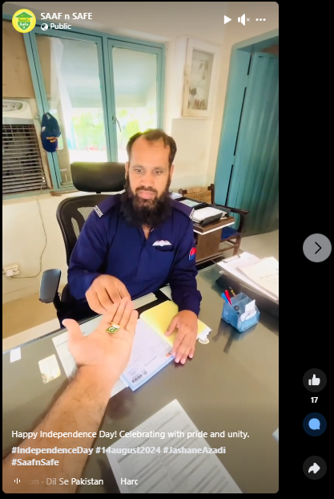

Posts were designed to celebrate Independence Day with full esteem and employee collaborations.

Slide 29
SIDEX POST CAMPAIGNS

Slide 30
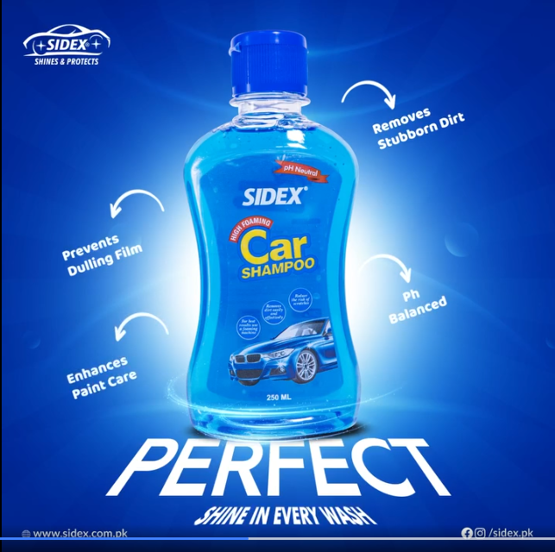
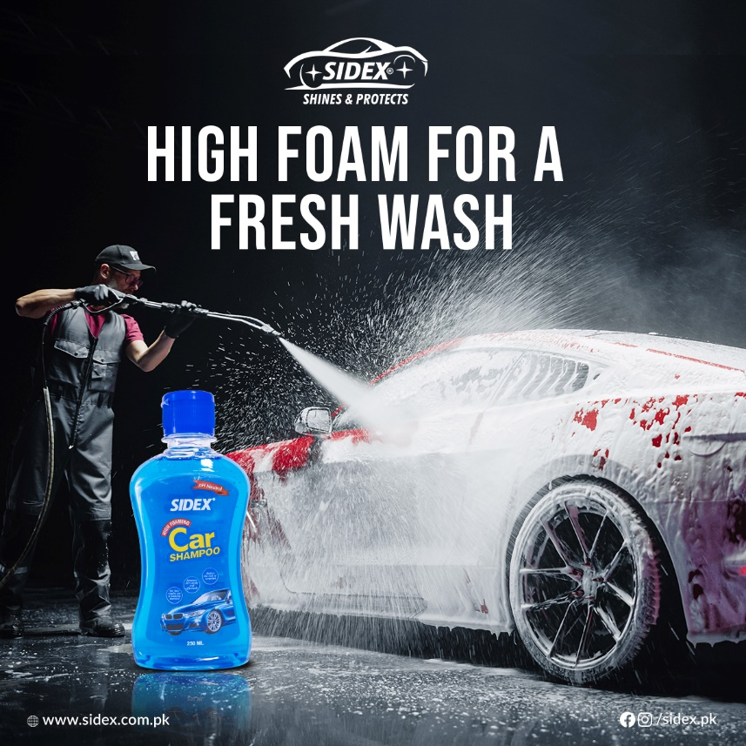

Posts were designed to promote the Car Shampoo Features and Benefits.

Slide 31


Posts were designed to promote the Windshield Cleaner in different scenarios.

Slide 32
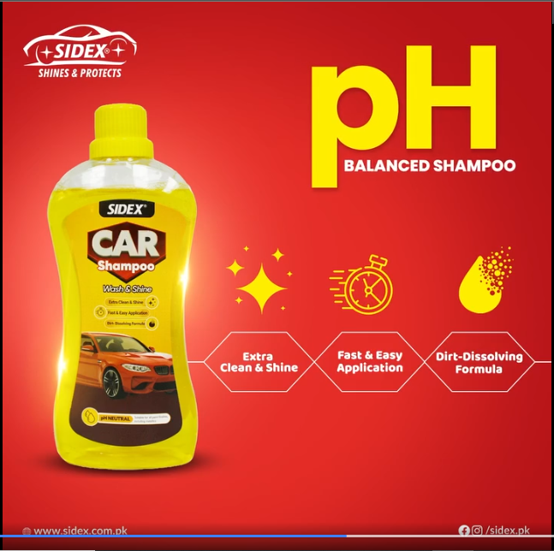
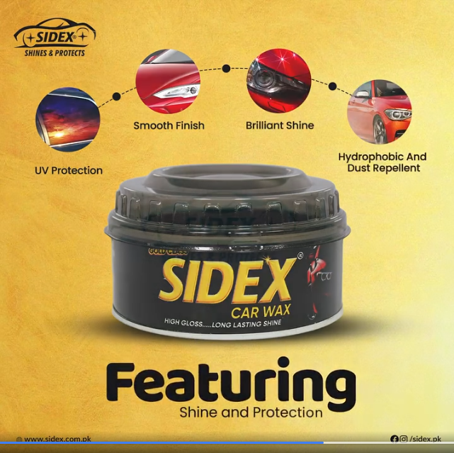
Posts were designed to promote Car Shampoo and Car Wax.

Slide 33


Posts were designed to show the trendy events and recall the special days.

Slide 34
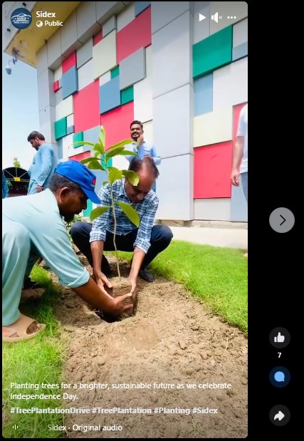


Posts were designed to celebrate Independence Day with full esteem and employee collaborations.

Slide 35
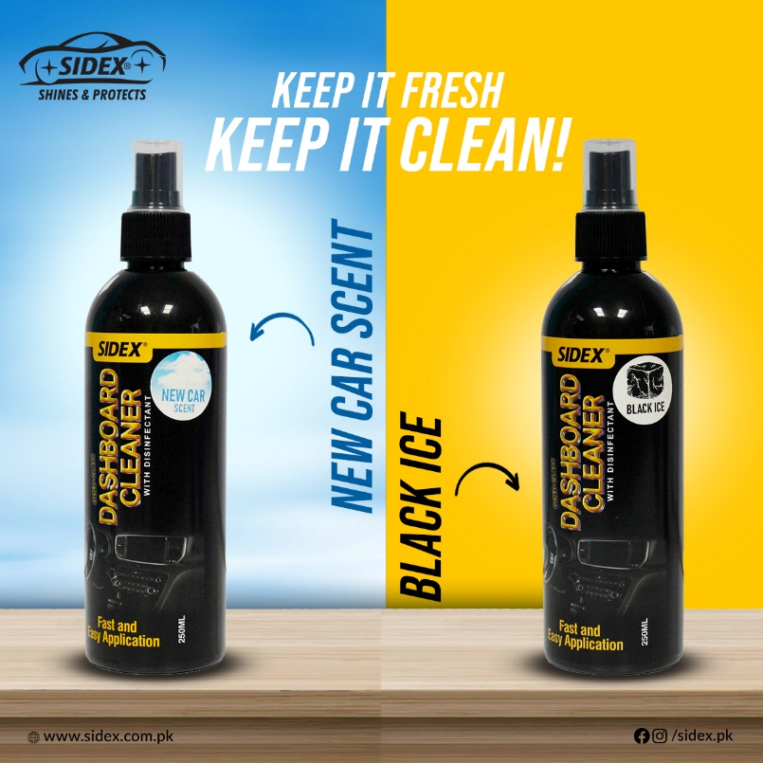


Posts were designed to promote Dashboard Polish and Dashboard Cleaner with two new variants.

Slide 36
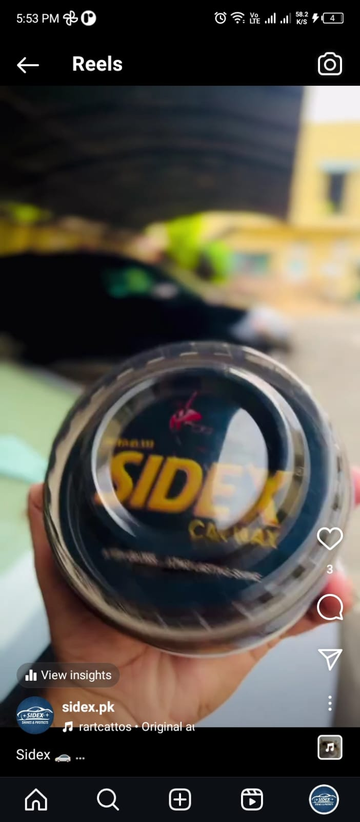
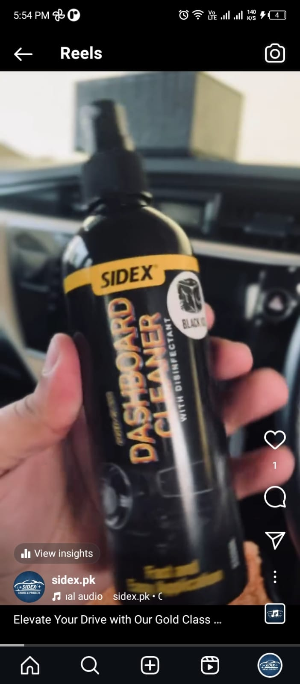
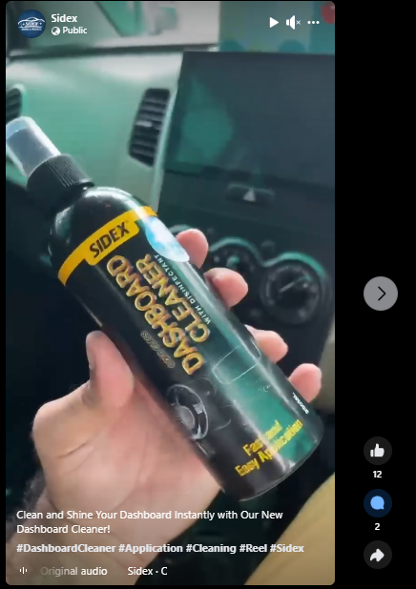
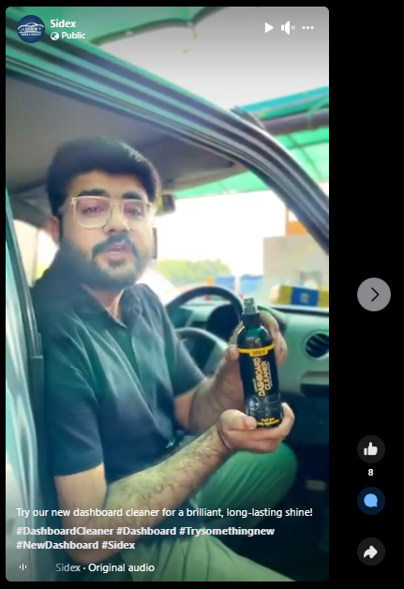
A campaign of Dashboard Cleaner Reels was created this month for Sidex.

Slide 37
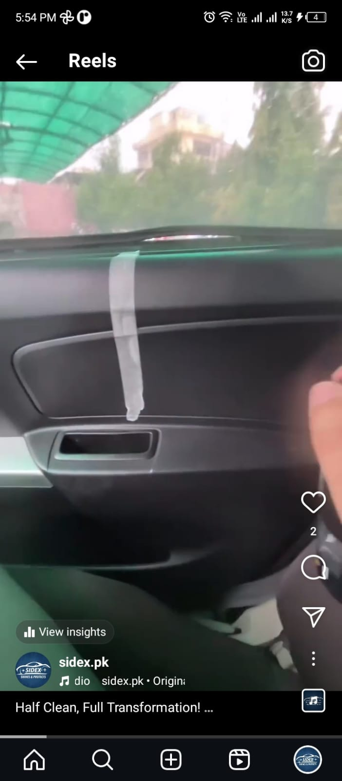
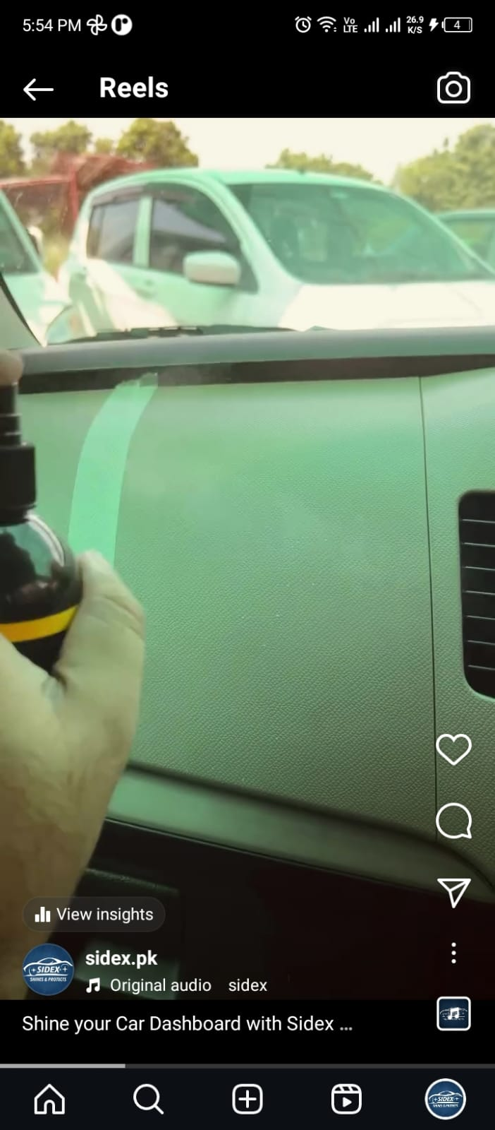
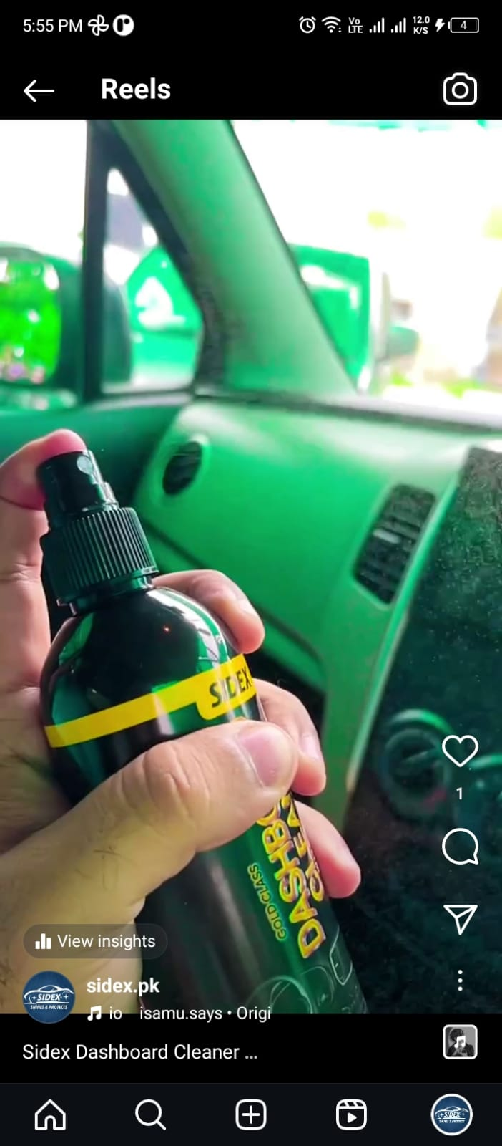
Reels were created to showcase the application of the dashboard cleaner.

Slide 38
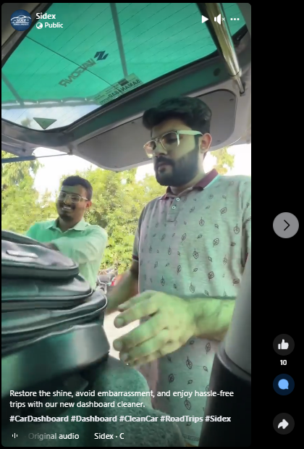
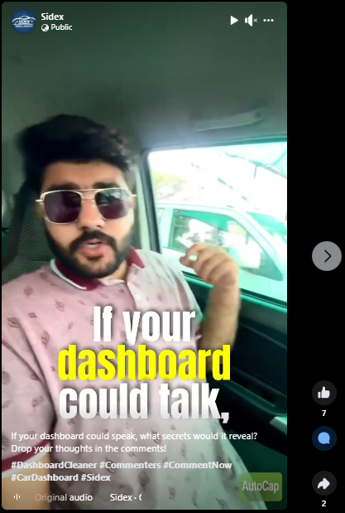
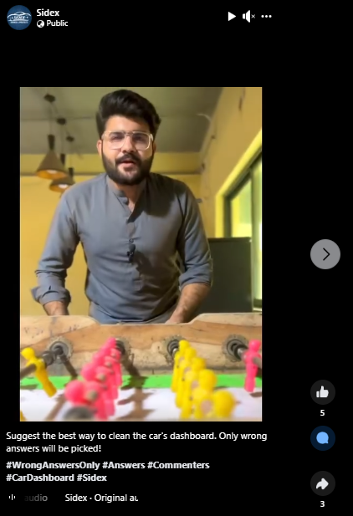
Engaging and creative Reels were developed to promote the Dashboard Cleaner.

Slide 39
FIXO POST CAMPAIGNS

Slide 40


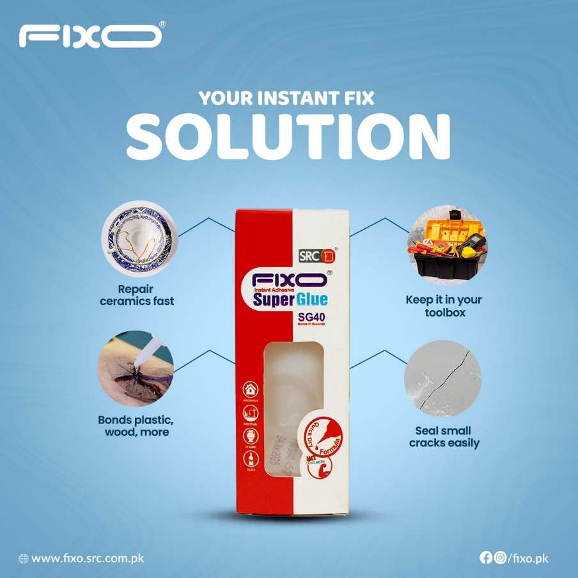
Posts were designed to promote the Super Glue with different benefits, features and applications.

Slide 41
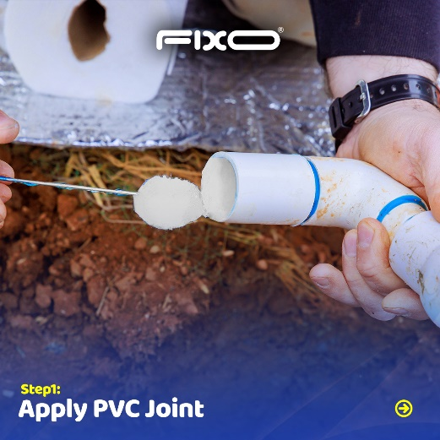
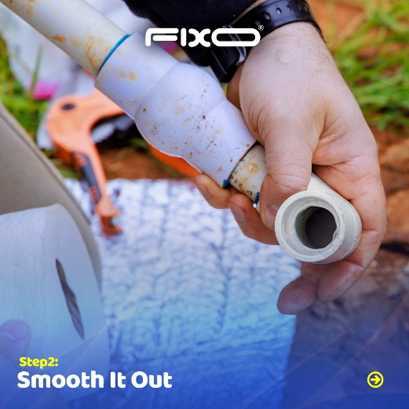



Posts were designed to showcase the ideal usage of PVC Weld for the awareness of professional workers.

Slide 42


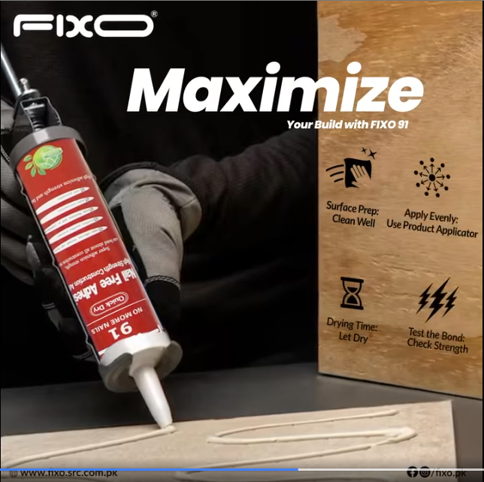
Posts were designed to showcase the FIXO 88, FIXO 91 and Ultra Glue Benefits and Features.

Slide 43

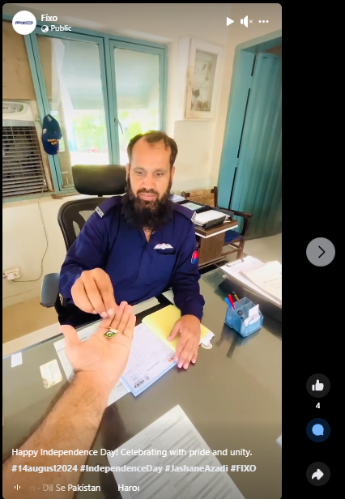

Posts and Reels were designed to celebrate independence day with full esteem and collaborations with employees.

Slide 44
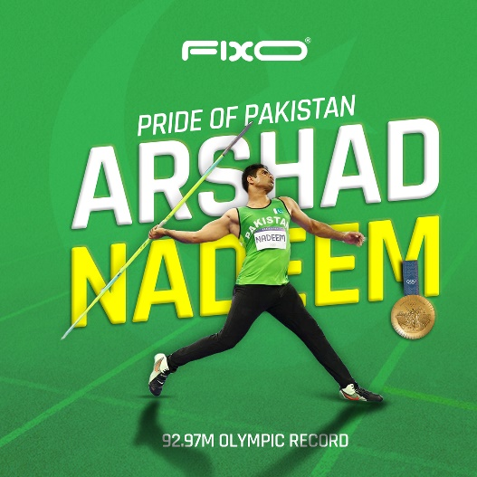

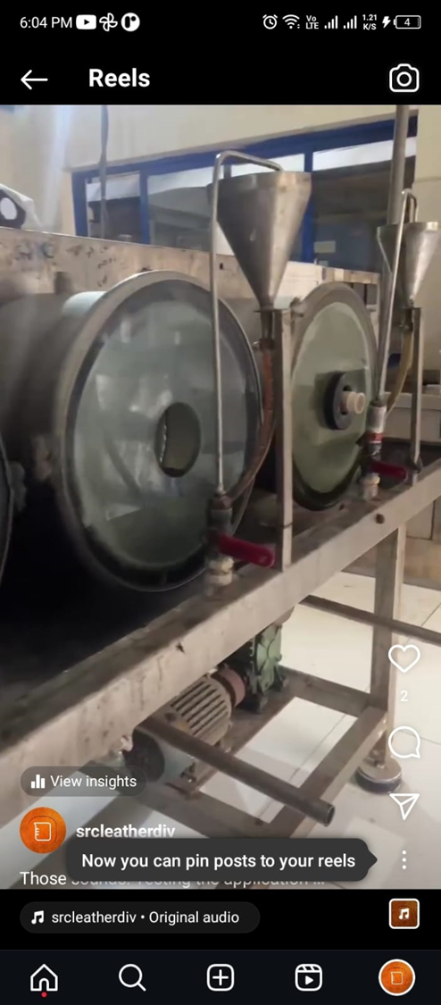

Posts and Reels were designed to showcase trendy events, special days, customer testimonials and beamhouse of SRC.

Slide 45
TAZA POST CAMPAIGNS

Slide 46



Posts and Short Animated Videos were designed to promote the Milk Benefits and showcasing the Farm of TAZA.

Slide 47


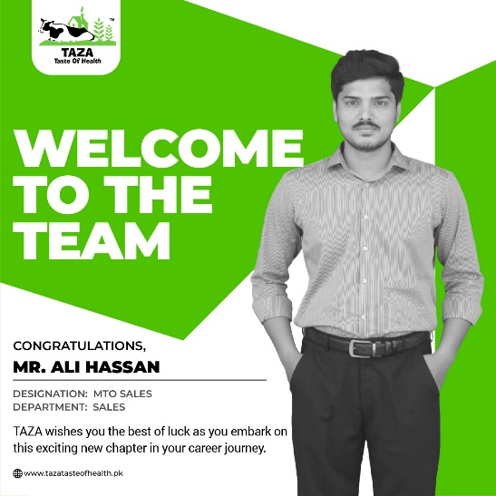


Posts were designed to Welcome the team, highlighting trendy events & commemorating special days.

Slide 48



Posts were designed to highlight the Salted and Unsalted Butter. A 14% Discount was also introduced this Azadi Week.

Slide 49
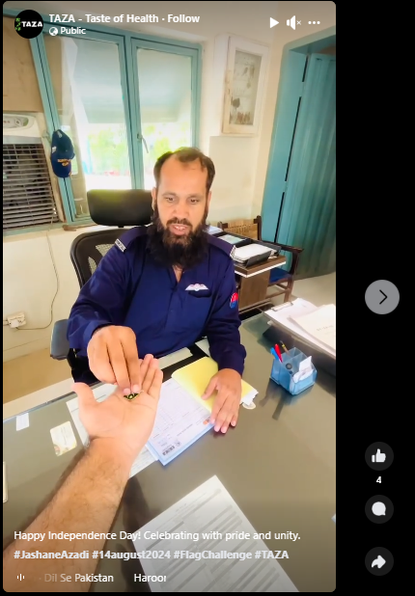
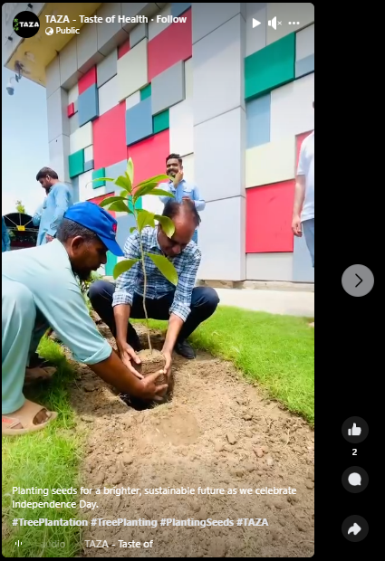
Reels were created to show the independence day events happened at SRC.

Slide 50


Posts were designed to highlight the features and benefits of TAZA Mango and Desi Ghee.

Slide 51
Page Professional Dashboard Overview

Slide 52
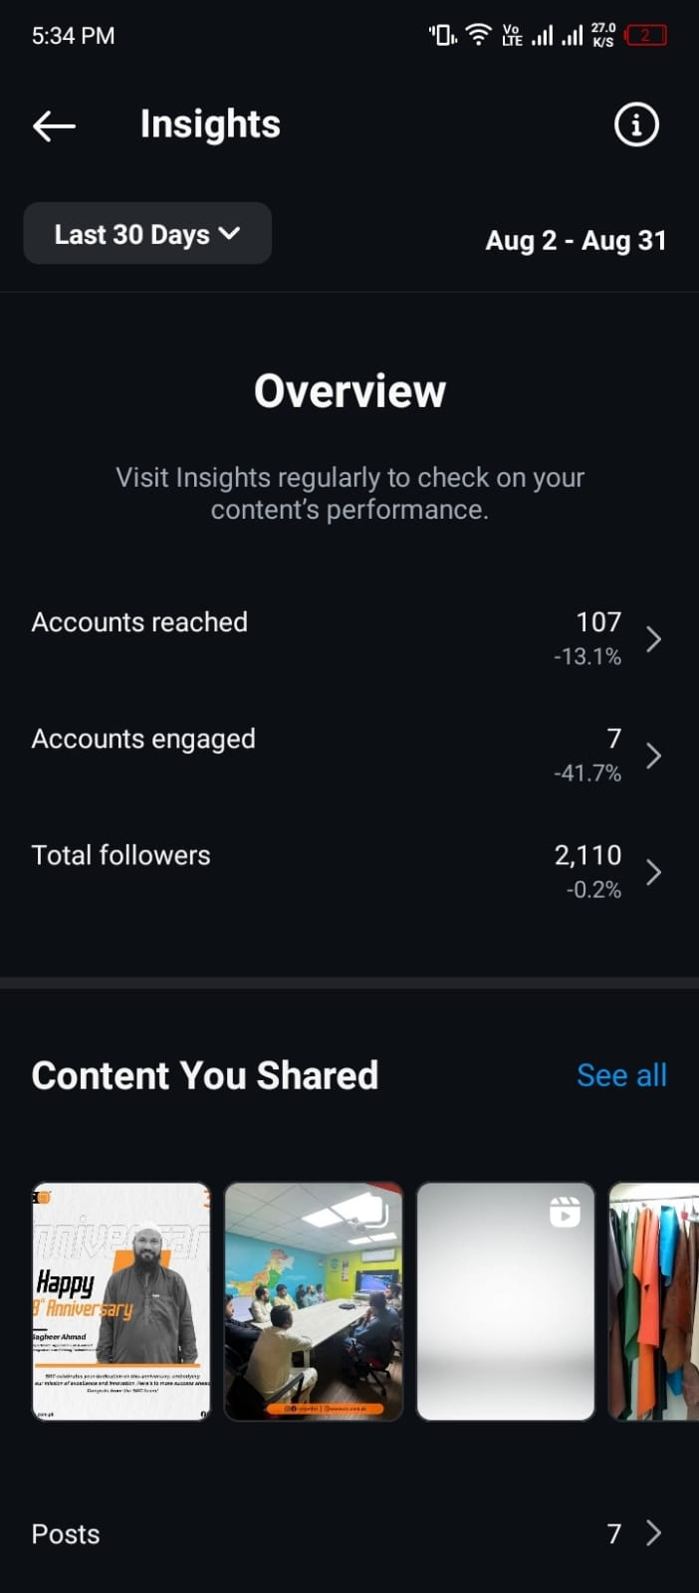
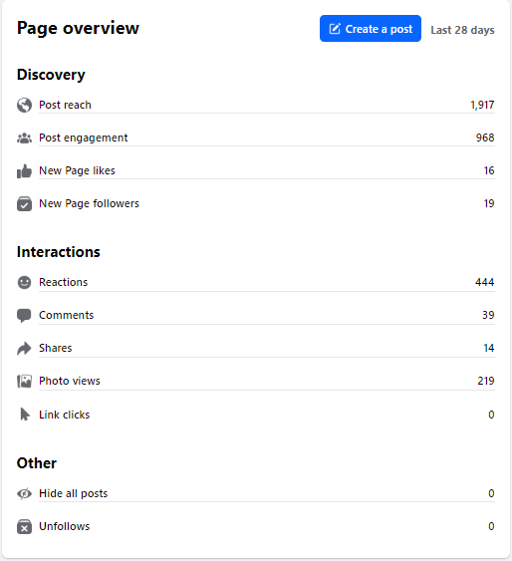
SRC SOCIAL MEDIA INSIGHTS OVERVIEW
Facebook Overview:
New Page Likes: 16
New Page Followers: 19
Instagram Overview:
Accounts Reached: 107
Accounts Engaged: 7
Total Followers: 2110

Slide 53
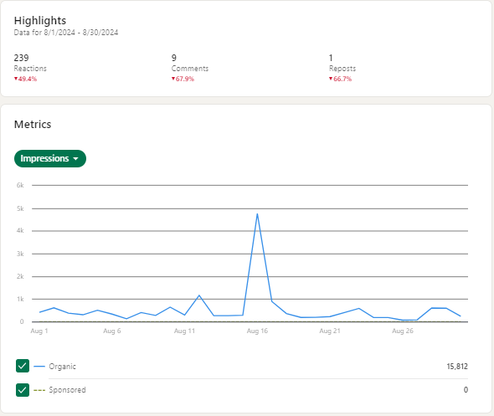
SRC LINKEDIN INSIGHTS OVERVIEW
Overview
Organic: 15,812
Sponsored: 0
An increased spike was recorded on 16 August.

Slide 54
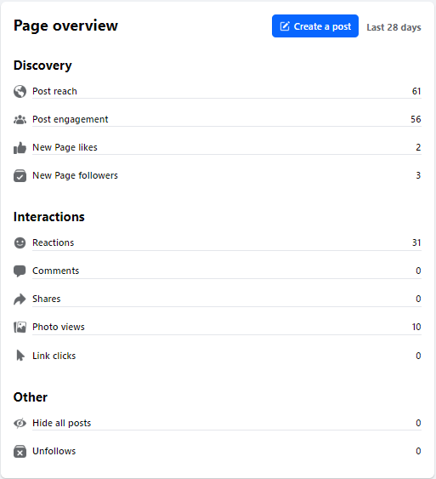

SRC LEATHER DIVISION SOCIAL MEDIA INSIGHTS OVERVIEW
Facebook Overview:
New Page Likes: 2
New Page Followers: 3
Instagram Overview:
Accounts reached: 139
Accounts engaged: 8
Total Followers: 15

Slide 55


SAAFNSAFE SOCIAL MEDIA INSIGHTS OVERVIEW
Facebook Overview:
New Page likes: 11
New Page Followers: 14
Instagram Overview:
Accounts Reached: 1825
Accounts Engaged: 35
Total Followers: 4319

Slide 56


SIDEX SOCIAL MEDIA INSIGHTS OVERVIEW
Facebook Page Overview:
New Page Likes: 6
New Page Followers: 10
Instagram Page Overview:
Account Reached: 939
Account Engaged: 30
Total Followers: 611

Slide 57


FIXO SOCIAL MEDIA INSIGHTS OVERVIEW
Facebook Overview:
New Page Likes: 2
New Page Followers: 3
Instagram Overview:
Accounts Reached: 10
Accounts Engaged: 1
Total Followers: 6

Slide 58

TAZA SOCIAL MEDIA INSIGHTS OVERVIEW
Reach: 49.6K
Content Interactions: 480
Followers: 29.2K

Slide 59

THANK YOU!

